Slide 1




NEXT GEN EMPLOYABILITY PROGRAM
Creating a future-ready workforce
Team Members
College Name
Student Name : Jerome Christopher J
Student ID : au311121104028
Loyola-ICAM College of Engineering and Technology

Slide 2

CAPSTONE PROJECT SHOWCASE
Project Title
MUSIC WEB APPLICATION USING DJANGO FRAMEWORK
Abstract | Problem Statement | Project Overview | Proposed Solution | Technology Used | Modelling & Results | Conclusion

Slide 3
Abstract
Rhythmix is a dynamic web application designed to revolutionize the way users interact with music online. With a sleek and intuitive interface, Rhythmix offers a comprehensive music streaming experience, allowing users to discover, listen to, and save their favorite songs. The platform features a vast library of songs spanning various genres, ensuring there's something for everyone. Users can create personalized playlists, save songs for later listening, and explore new music through an innovative recommendation system. Rhythmix aims to elevate the online music experience by providing a seamless and enjoyable platform for music enthusiasts worldwide.
Source :

Slide 4
Problem Statement
The current landscape of online music streaming platforms often lacks personalization and user-friendly interfaces. Users may struggle to find music that suits their preferences or have difficulty organizing their favorite songs into playlists. Additionally, existing platforms may not offer convenient features like saving songs for later listening or providing personalized recommendations. This creates a gap in the market for a music streaming platform that combines a vast library of songs with intuitive features for personalized music discovery and organization.
Source :

Slide 5
Project Overview
Rhythmix addresses the shortcomings of existing music streaming platforms by offering a user-centric approach to music consumption. The platform boasts a user-friendly interface, robust search functionality, and personalized features such as playlist creation and song saving. By leveraging advanced algorithms, Rhythmix delivers tailored music recommendations based on user preferences, enhancing the overall listening experience. Furthermore, the platform's responsive design ensures accessibility across devices, allowing users to enjoy their favorite tunes anytime, anywhere. Rhythmix aims to redefine the online music streaming experience and become the go-to destination for music enthusiasts worldwide.
Source :

Slide 6
Proposed Solution
.
The proposed solution for Rhythmix is a comprehensive web application designed to offer a seamless music streaming experience while prioritizing personalization and user engagement. At its core, Rhythmix will provide users with a platform where they can create accounts, log in, and manage personalized profiles. These profiles will store user preferences, playlists, and saved songs, facilitating personalized music recommendations and tailored experiences.
The application will boast a diverse music library spanning various genres, artists, and albums, complemented by robust search functionality. Users will be able to easily discover music by title, artist, album, or genre. Additionally, Rhythmix will leverage machine learning algorithms to analyze user listening history, preferences, and interactions, generating personalized music recommendations such as similar songs, artists, and playlists.
Source :

Slide 7
Users will have the ability to create custom playlists by adding songs from the music library, enabling them to curate their own personalized collections. The introduction of a "Watch Later" feature will allow users to save songs for later listening, enhancing convenience and encouraging return visits to the platform.
To ensure a seamless user experience, Rhythmix will be developed with a responsive design, catering to users across various devices, including desktops, tablets, and mobile phones. The user interface will prioritize intuitive navigation, clear calls-to-action, and visually appealing elements to enhance usability and accessibility.
Furthermore, the platform will incorporate analytics and user feedback mechanisms to gather insights into user behavior and preferences. This data will drive continuous improvement, enabling Rhythmix to iterate and enhance the platform continually, ultimately fostering user satisfaction, engagement, and loyalty.
Source :

Slide 8


Technology Used
Front-end
Back-end
Source :

Slide 9
Modelling & Results
Modeling:
User Model: This includes user authentication details (username, email, password) and additional profile information.
Song Model: Contains details about each song, including title, artist, album, genre, and the file path to the audio file.
Playlist Model: Represents user-created playlists, containing a list of songs associated with each playlist.
Watch Later Model: Stores the songs that users have marked to watch later.
Interaction Model: Tracks user interactions with the platform, such as song plays, likes, and playlist creations.
Source :

Slide 10
Result:
User Authentication: Users can sign up, log in, and manage their profiles.
Music Library: Displays a vast collection of songs categorized by artist, album, and genre.
Search Functionality: Allows users to search for songs, artists, or albums.
Personalized Recommendations: Utilizes machine learning algorithms to recommend songs based on user preferences and listening history.
Custom Playlists: Enables users to create and manage custom playlists, adding or removing songs as desired.
Watch Later Feature: Allows users to save songs for later listening.
Responsive Design: Ensures seamless user experience across various devices.
Analytics: Provides insights into user behavior and preferences, aiding in platform optimization and content curation.

Slide 11
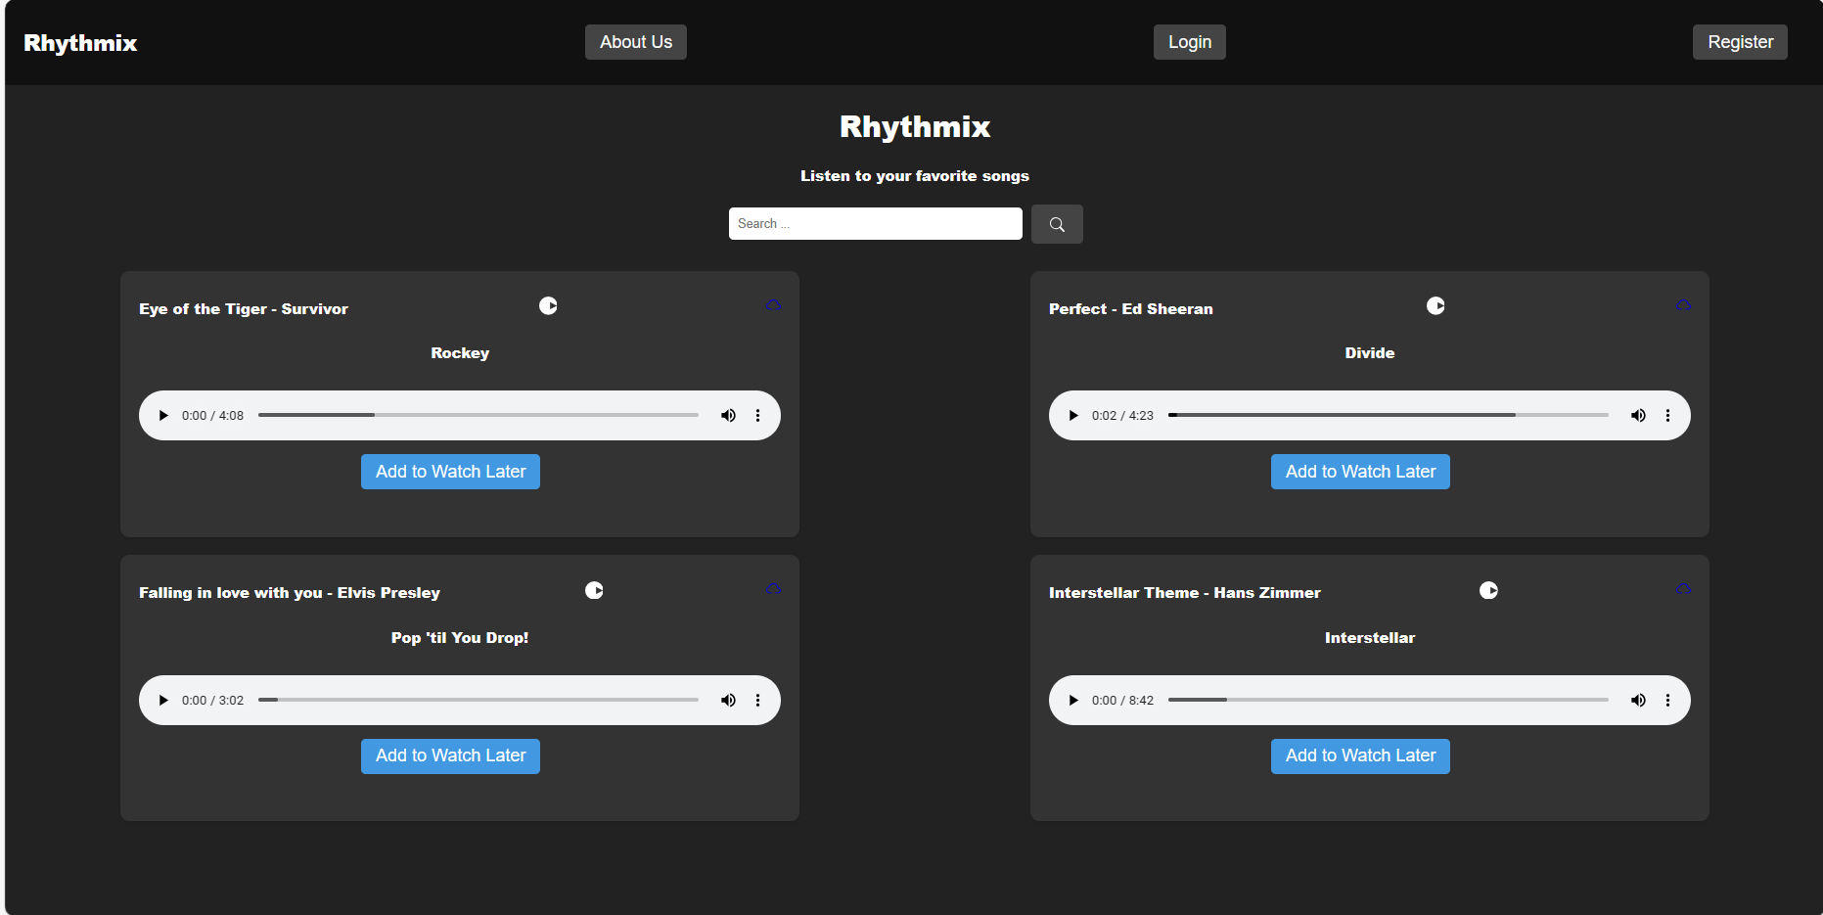
Homepage

Slide 12
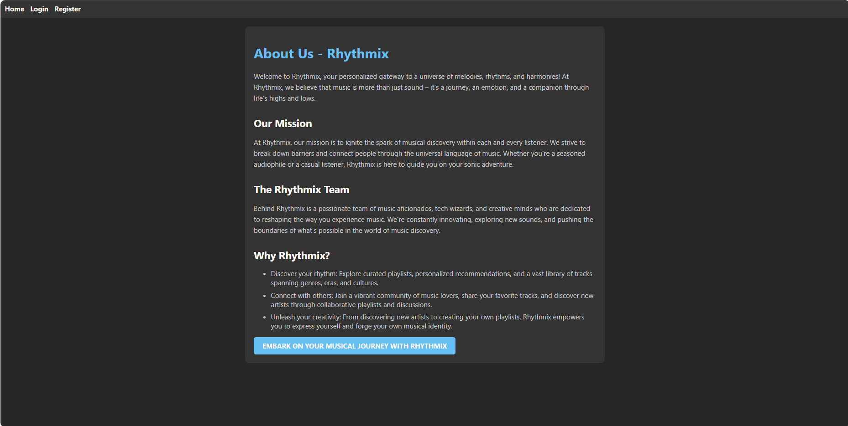
About-Us-Page

Slide 13

Login-Page

Slide 14

Register-Page

Slide 15

Watch_Later-Page

Slide 16
Future Enhancements:
Social Integration: Allow users to connect with friends, follow their playlists, share songs, and see what their friends are listening to.
Advanced Recommendation System: Implement more sophisticated recommendation algorithms, such as collaborative filtering or content-based filtering, to provide even more personalized song suggestions.
User-Generated Content: Enable users to upload their own music tracks, podcasts, or audiobooks to the platform, expanding the content library.
Live Streaming: Introduce live streaming capabilities for concerts, DJ sets, or other live events, providing users with real-time entertainment experiences.
Lyrics Integration: Integrate lyrics for songs, allowing users to sing along while listening to their favorite tracks.
Podcast Support: Incorporate support for podcasts and other spoken-word content, diversifying the platform's content offerings.
Offline Mode: Implement an offline mode feature that allows users to download songs or playlists for offline listening, particularly useful for users with limited internet connectivity.
Customizable Themes: Provide users with the ability to customize the platform's theme, including color schemes, background images, and font styles, enhancing the visual experience.

Slide 17
Cross-Platform Compatibility: Develop mobile apps for iOS and Android devices, ensuring seamless access to the platform across all devices.
Concert Tickets Integration: Partner with ticketing platforms to offer users the ability to purchase tickets to concerts, festivals, or other live events directly through the platform.
Artist Profiles: Create dedicated profiles for artists, featuring biographies, discographies, upcoming tour dates, and other relevant information.
Localized Content: Expand the platform's content library to include music from a wide range of cultures and languages, catering to diverse global audiences.
Integration with Smart Devices: Enable integration with smart speakers, smart TVs, and other IoT devices, allowing users to stream music directly to their connected devices.
Interactive Features: Introduce interactive features such as polls, quizzes, or live chat during music playback, enhancing user engagement and interactivity.
Virtual Reality (VR) Experience: Develop a virtual reality experience where users can attend virtual concerts, explore immersive music environments, or interact with virtual avatars of their favorite artists.

Slide 18
Conclusion
In conclusion, our music streaming platform aims to revolutionize the way users engage with their favorite music. By prioritizing user experience and offering intuitive features, we strive to create an immersive environment for music enthusiasts. With ongoing enhancements like social integration and personalized recommendations, we're committed to evolving the platform to meet the ever-changing needs of our users. This project signifies a significant advancement in delivering a modern and enjoyable music listening experience for all.
Source :

Slide 19
Thank You!
Notes:
Thank You !!

